Slide 1





PHISHING EMAIL DETECTION
Samardeep Gurudatta
Data Modelling and Optimization
Mahadevan Iyer
Data Engineering and Extraction
Rohan Shukla
Data Preprocessing, Feature Engineering
Meghana Boinpally
Data Preprocessing, Feature Engineering

Slide 2
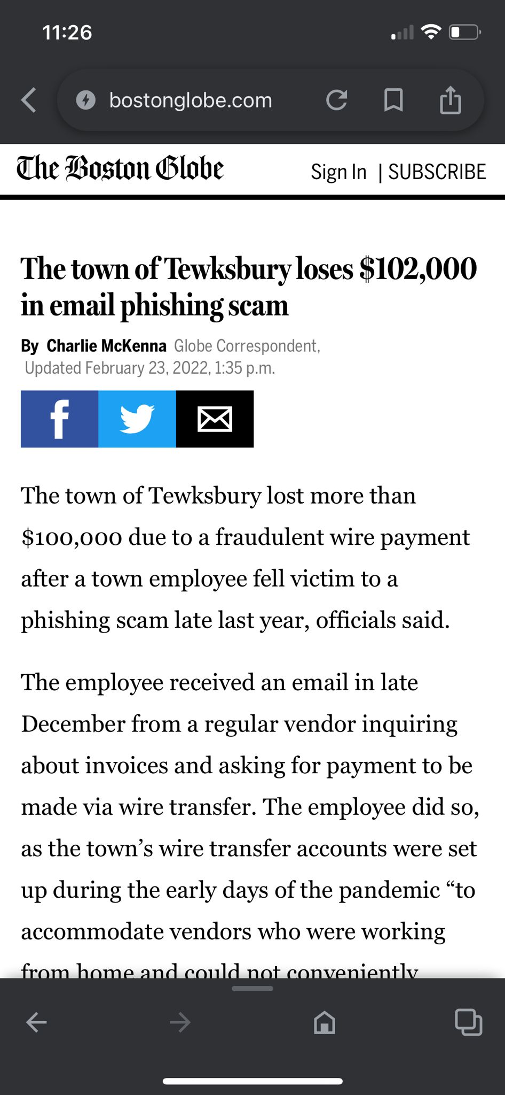

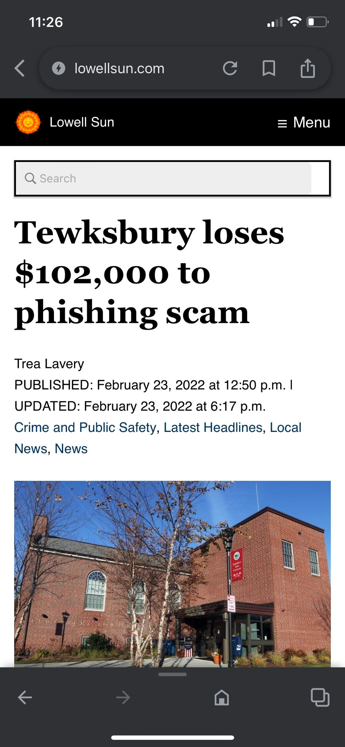
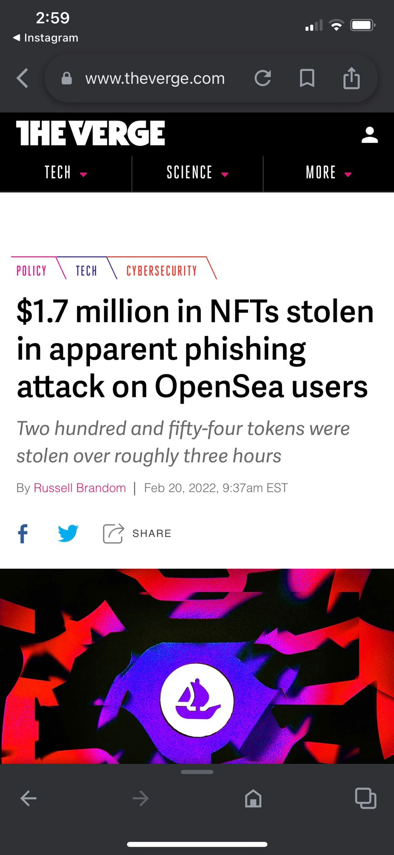
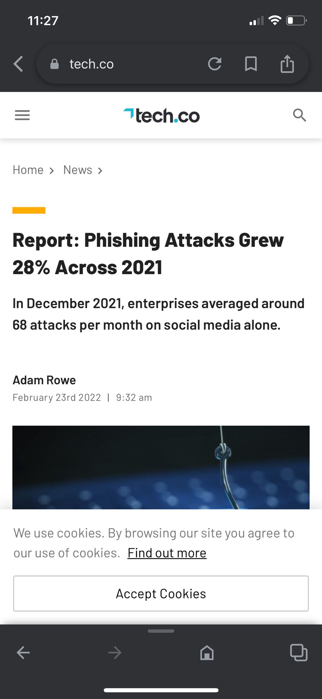
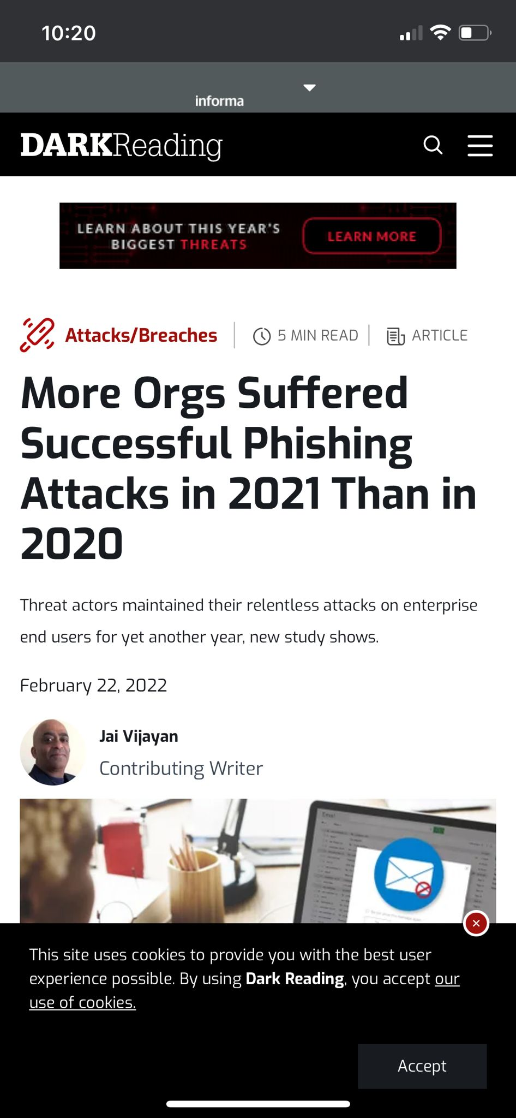
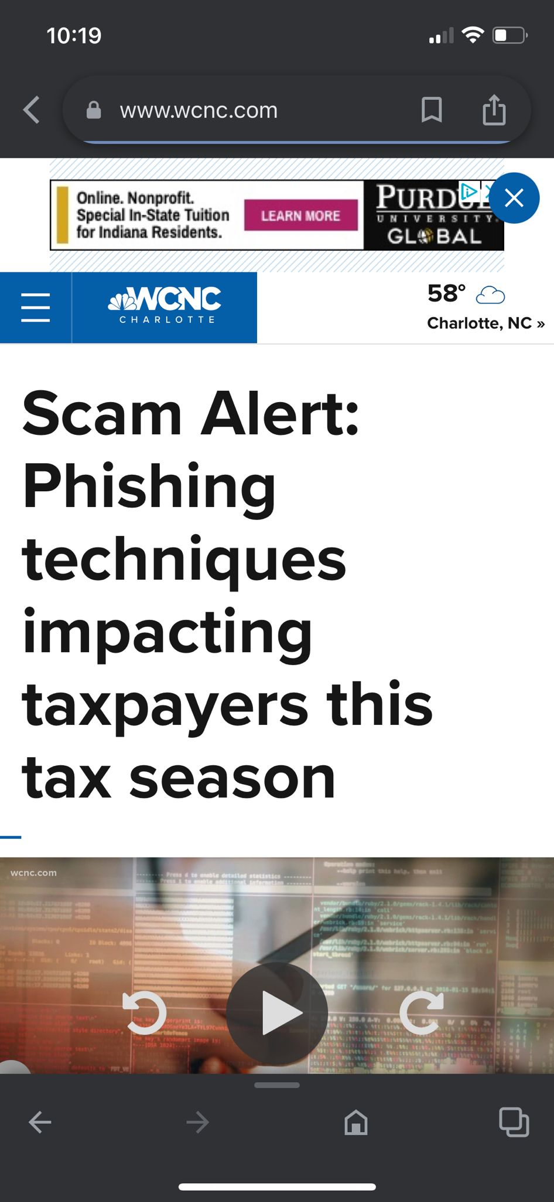

Cloning
Spear Phishing
Email Phishing
Whaling

Slide 3
DATA COLLECTION
Enron corpus
Few Shot Learning
Parsed it to csv
Nazario corpus

Slide 4
DATA WRANGLING
Identified and Restructured metadata
Text Cleaning
Text Mapping and Generalization
Handled Class Imbalance

Slide 5
We protect the end user from
Malicious URLs
Brand Imposters
Business Email Compromise
Link and Domain analysis
Content analysis
Meta data analysis

Slide 6
DOMAIN ANALYSIS
FRAUDULENT DOMAIN
MALICIOUS URL
WHITELISTING URLS
FROM:
no-reply@ebuy.com
FROM:
w-confirm@ebay.com
FROM:
sender@domain.com
Links:
http://pages.ebay.com
https://sign-in.eby.com
Links:
https://images.ebay.com
http://251.120.83.1
http://login-member.rcmail.eu
Links:
https://mobile.msn.com
http://teams.microsoft.com
FROM:
sender@domain.com
Links:
https://microsoft.jindo.com

Slide 7
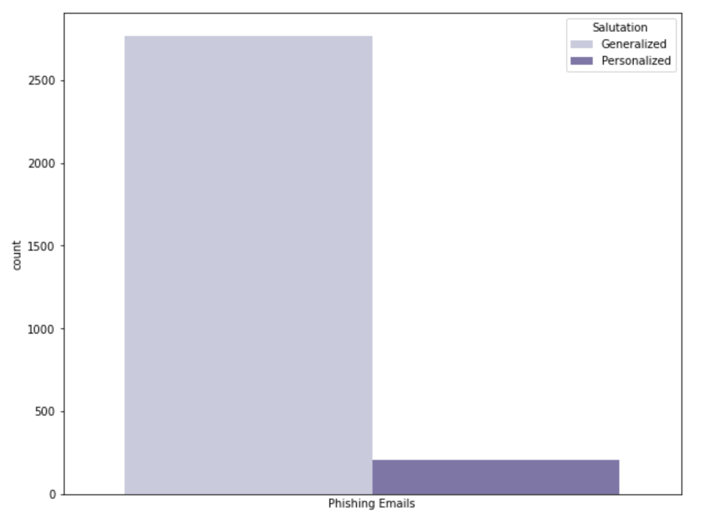
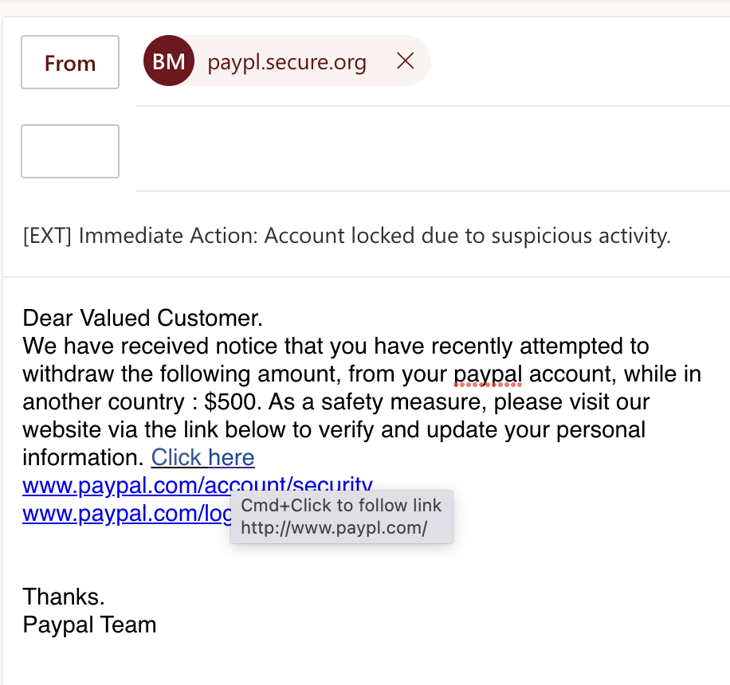
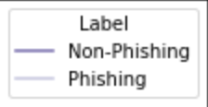
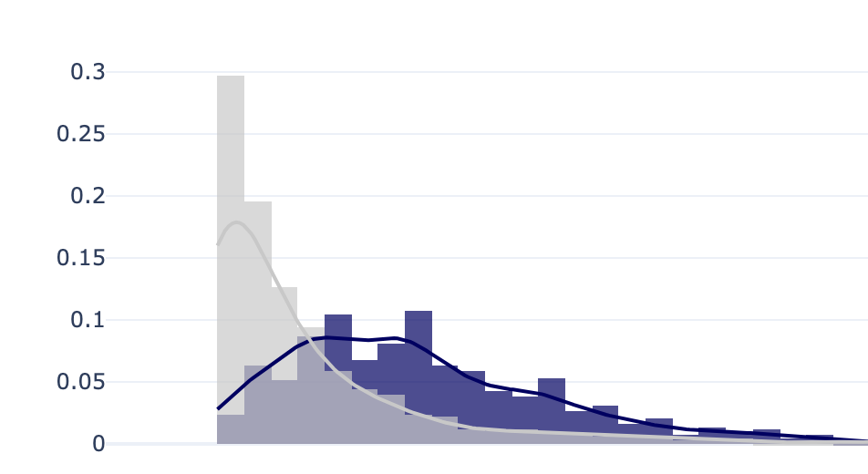
CONTENT ANALYSIS
Generalized Salutation
Call For
Action

Slide 8
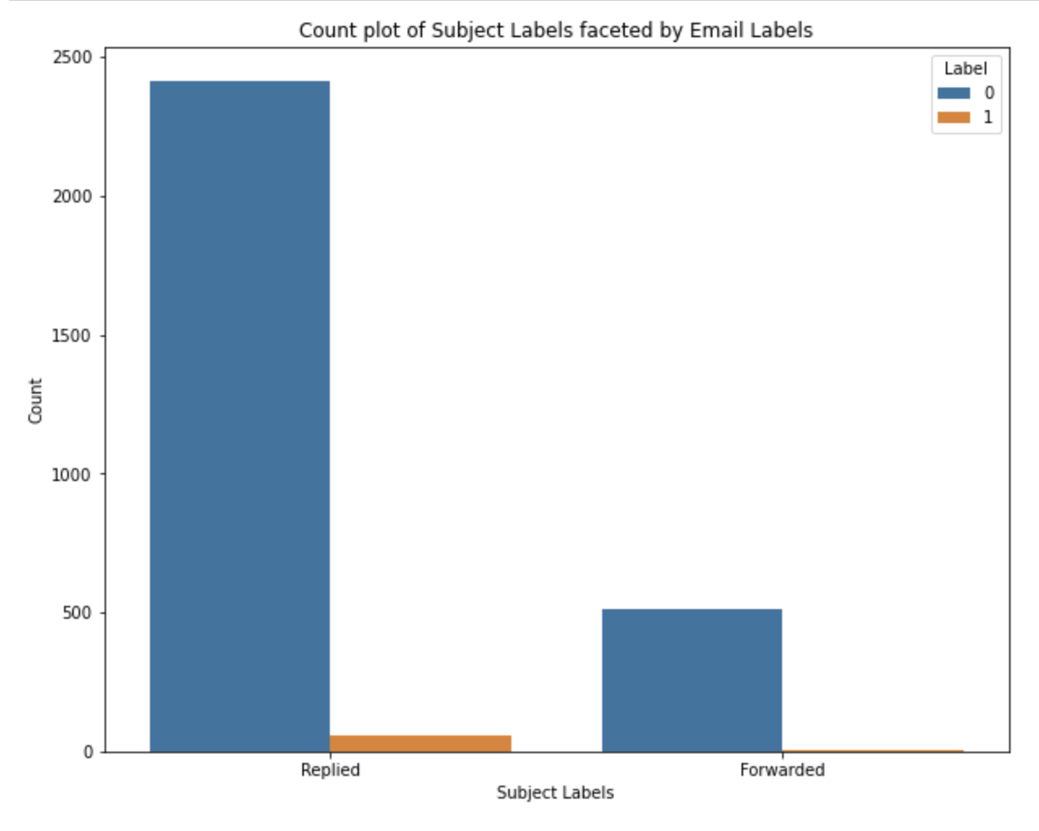
METADATA ANALYSIS
Email Subject Abbreviations
Subject
Urgency

Slide 9
ALGORITHMS IMPLEMENTED
Decision Tree
0.75
Bagging
Classification Algorithms
Boosting
Random Forest
0.84
XG Boost
0.95
Metric: ROC-AUC

Slide 10
FUTURE SCOPE
Learn and update the best predictor for future data at every step using Online learning
Expanding the scope against phishing attacks to include social media and instant messaging
Customizable filter rules so that administrators can define their own policies for blocking
Spam Emails
Bulk Campaigns
Unsolicited Marketing materials

Slide 11
THANK YOU

